Slide 1

Advanced course
Lesson 25
DIY coures（3）
Smart home system
YahBoom Croco:Kit tutorial

Slide 2
Advanced course
Content
Part1
Part 2
Part3
Part 4
Part 5
Learning goals
Preparation
Connection
Search for blocks
Combine blocks
YahBoom Croco:Kit tutorial

Slide 3
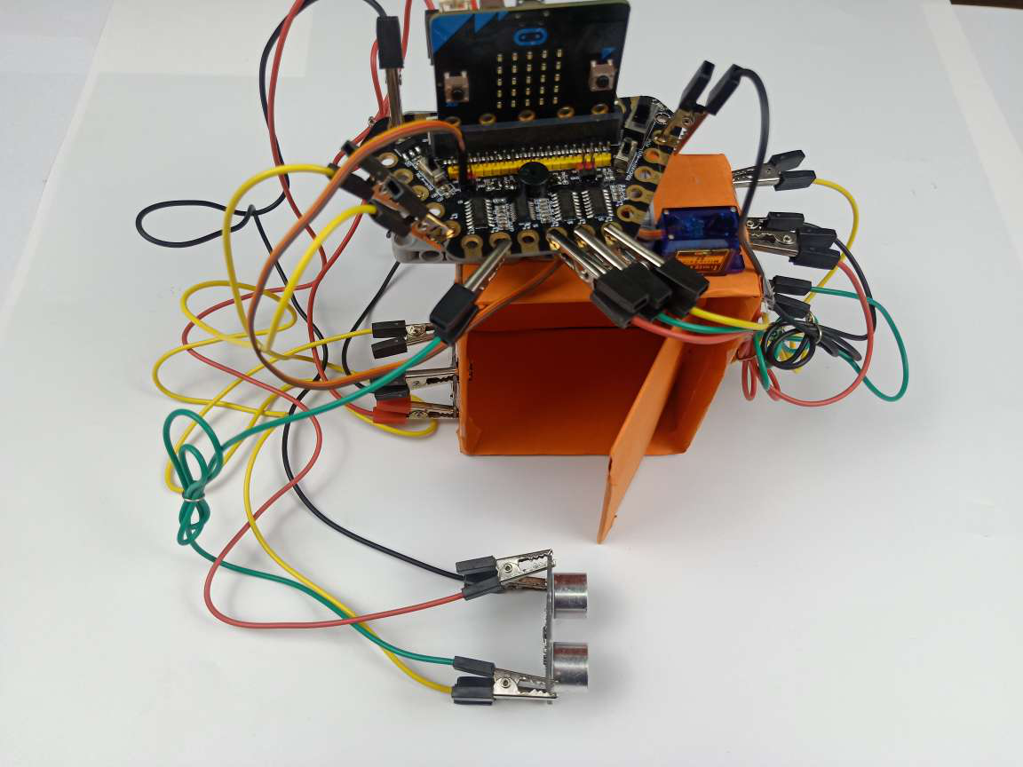
Advanced course
Part 1
Learning goals
After downloading the program, we can see the word 'Happy Birthday!' on the Micro:bit LED dot matrix. When the ultrasound module detects that someone is approaching, Micro:bit LED dot matrix will display a smile, opens the door and lights up RGB light at home.
When the person walks into the house, the door will close automatically and RGB light will close, Micro:bit LED dot matrix clear screen.
YahBoom Croco:Kit tutorial

Slide 4
Advanced course
Part 2
Hardware:
● 1 X Micro:bit Board
● 1 X Micro USB Cable
● 1 X Diamond breakout
● 1 X RGB light module
● 1 X Ultrasonic module
● 11 X Alligator clip
● 1 X Servo
● 1 X Infrared sensor
● 1 X PC
Preparation
Mode 1 online programming: First, we need to connect the micro:bit to the computer by USB cable. The computer will pop up a USB flash drive and click on the URL in the USB flash drive: http://microbit.org/ to enter the programming interface. Add the Yahboom package: https://github.com/lzty634158/Croco-Kit to program.
Mode 2 offline programming: We need to open the offline programming software. After the installation is complete, enter the programming interface, click【New Project】, add Yahboom package: https://github.com/lzty634158/Croco-Kit , you can program.
YahBoom Croco:Kit tutorial

Slide 5
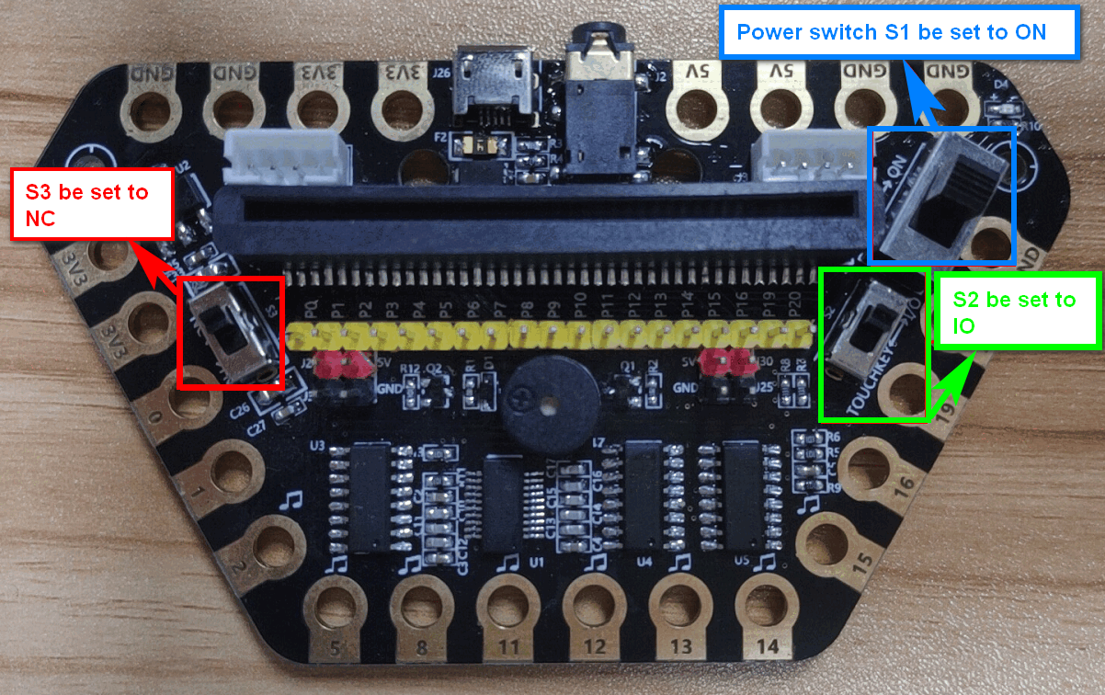
Advanced course
Part 2
Preparation
! ! !Note: S1 be set to the ON, S2 be set to the IO, and S3 to the NC.
YahBoom Croco:Kit tutorial

Slide 6
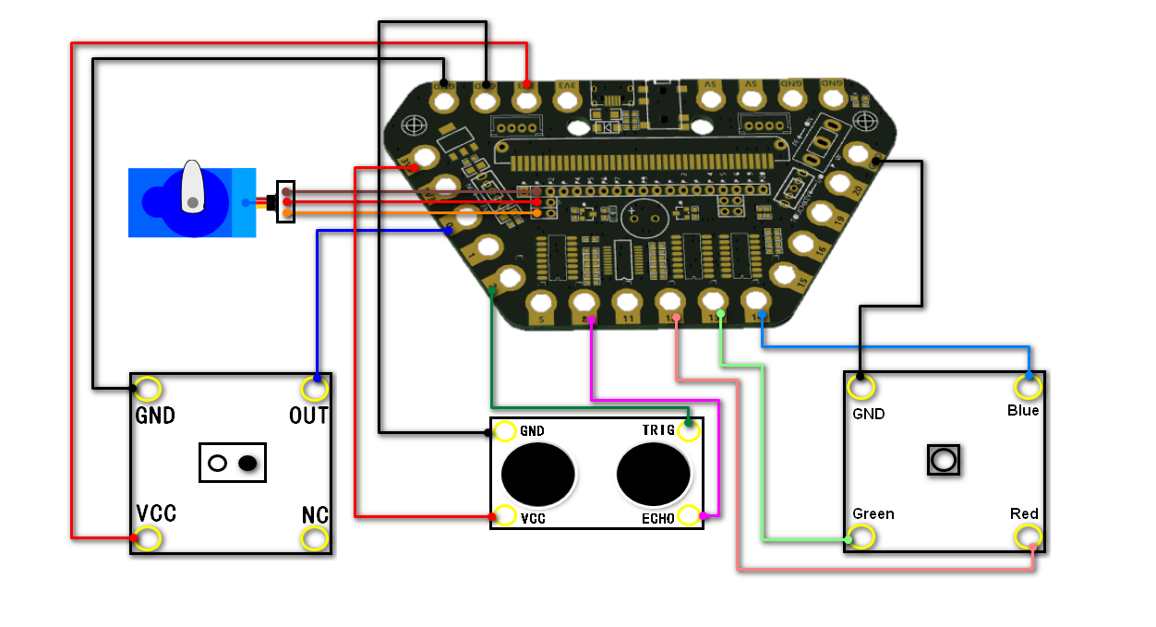
Advanced course
Part 3
Connection
YahBoom Croco:Kit tutorial

Slide 7
Advanced course
Part 3
Expansion board | Infrared Module | Servo | Ultrasonic module | RGB module
P0 | OUT
P1 |  | Orange line
P2 |  |  | TRIG
P8 |  |  | ECHO
P12 |  |  |  | Red
P13 |  |  |  | Green
P12 |  |  |  | Blue
3.3V | VCC |  | VCC
5V |  | Red line
GND | GND | Black line | GND | GND
Connection
YahBoom Croco:Kit tutorial

Slide 8
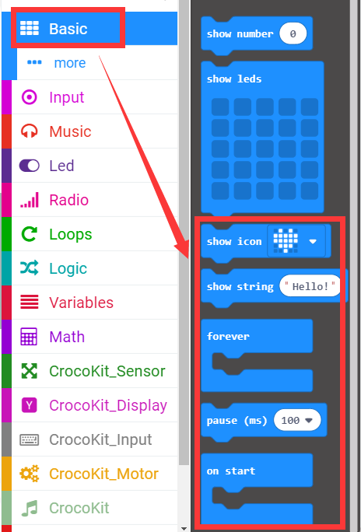
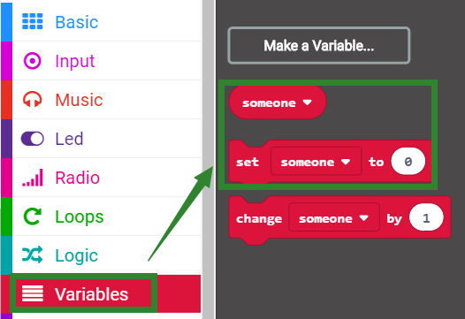
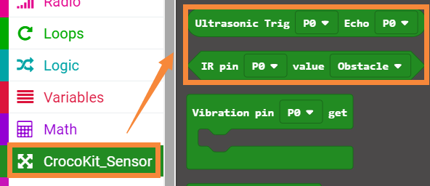
Advanced course
Part 4
Search for blocks
YahBoom Croco:Kit tutorial

Slide 9
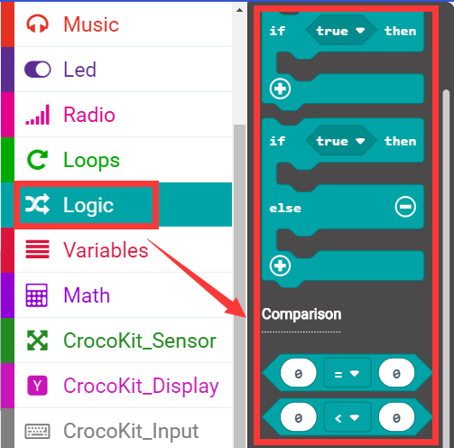
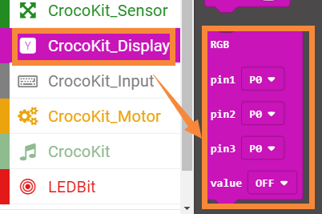
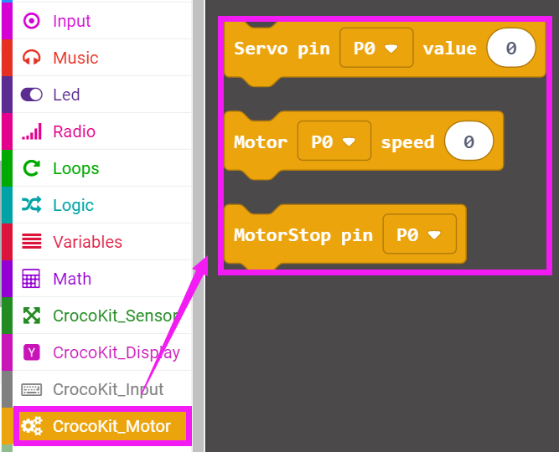
Advanced course
Part 4
Search for blocks
YahBoom Croco:Kit tutorial

Slide 10
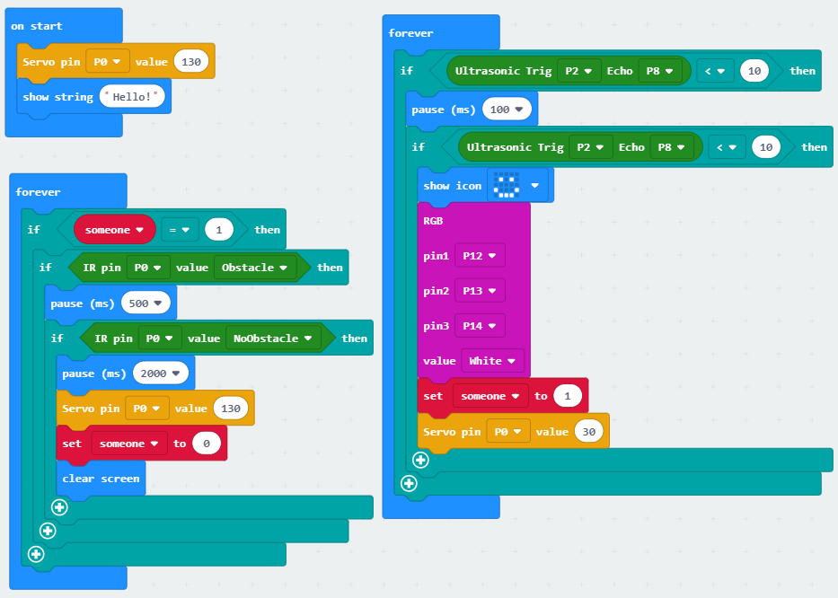
Advanced course
Part 5
Combine blocks
YahBoom Croco:Kit tutorial

Slide 11
Advanced course
Thank you ！
Powered by YahBoom
YahBoom Croco:Kit tutorial

